Slide 1
Lab 6: ML in AWS
Sufyan Shaikh
Charles Andre

Slide 2
Before We Start With AWS
3 Tasks
→ Create a scatterplot of the data, taking into account all combinations of data.
→ Selection and modeling of an ML Algorithm
→ Use first 200 of each classification data as Training Data for ML algorithm and report results

Slide 3
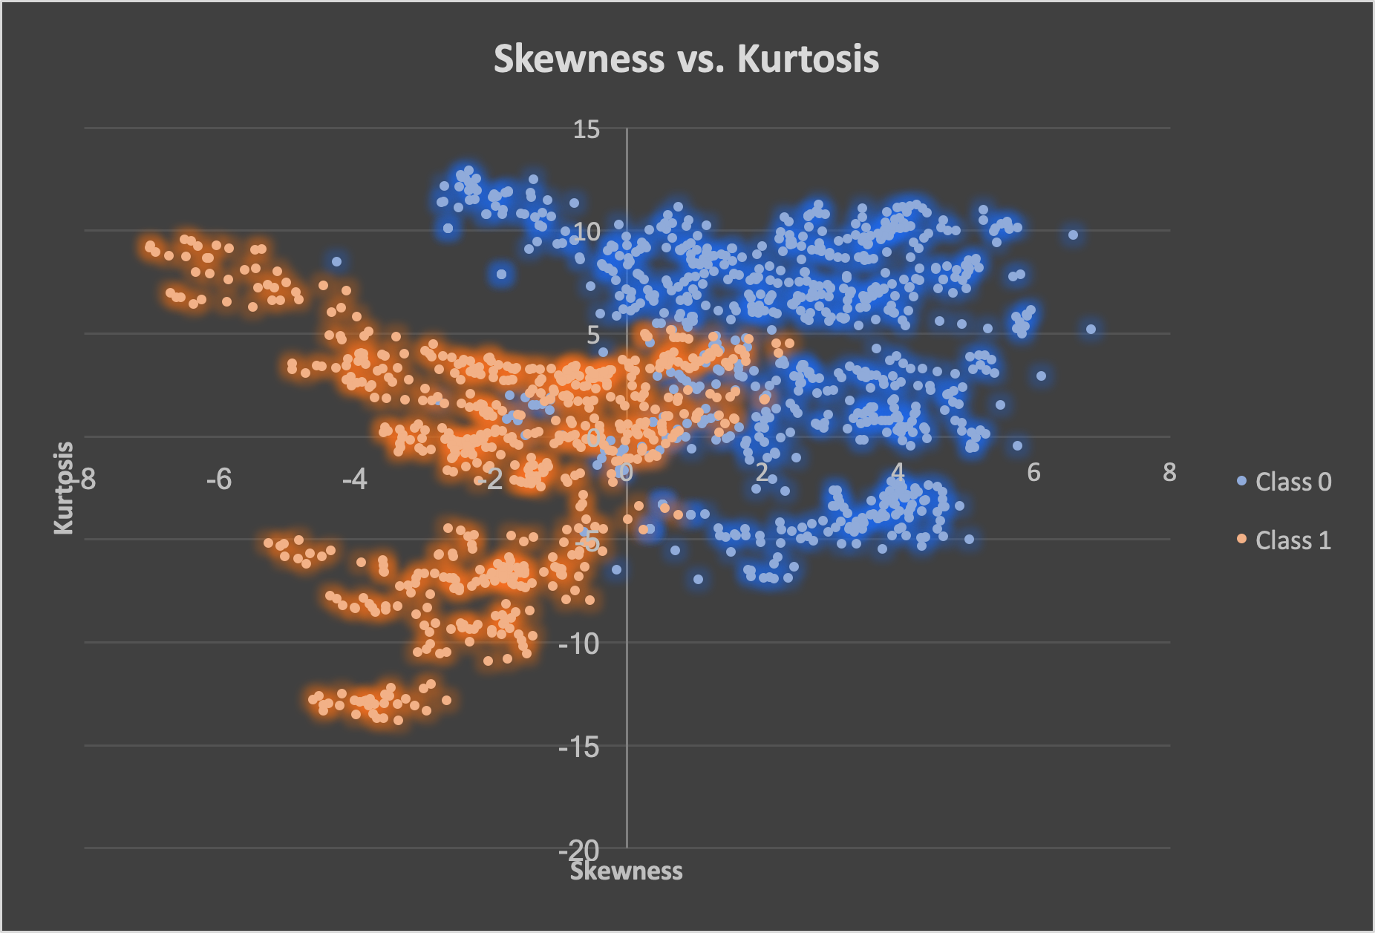
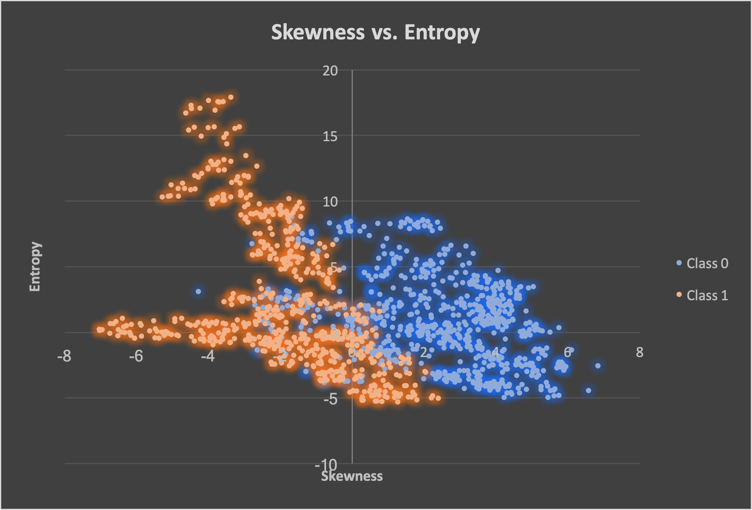
Scatterplots
→ Exported data into excel and used excel to create these scatterplots.

Slide 4
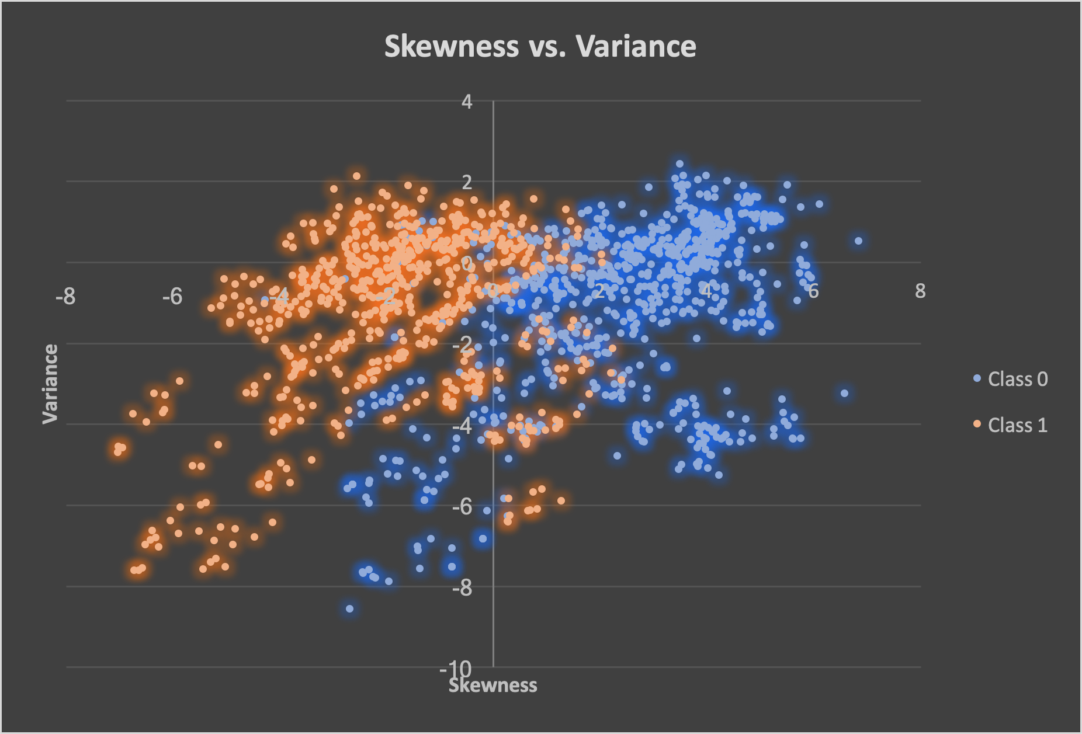
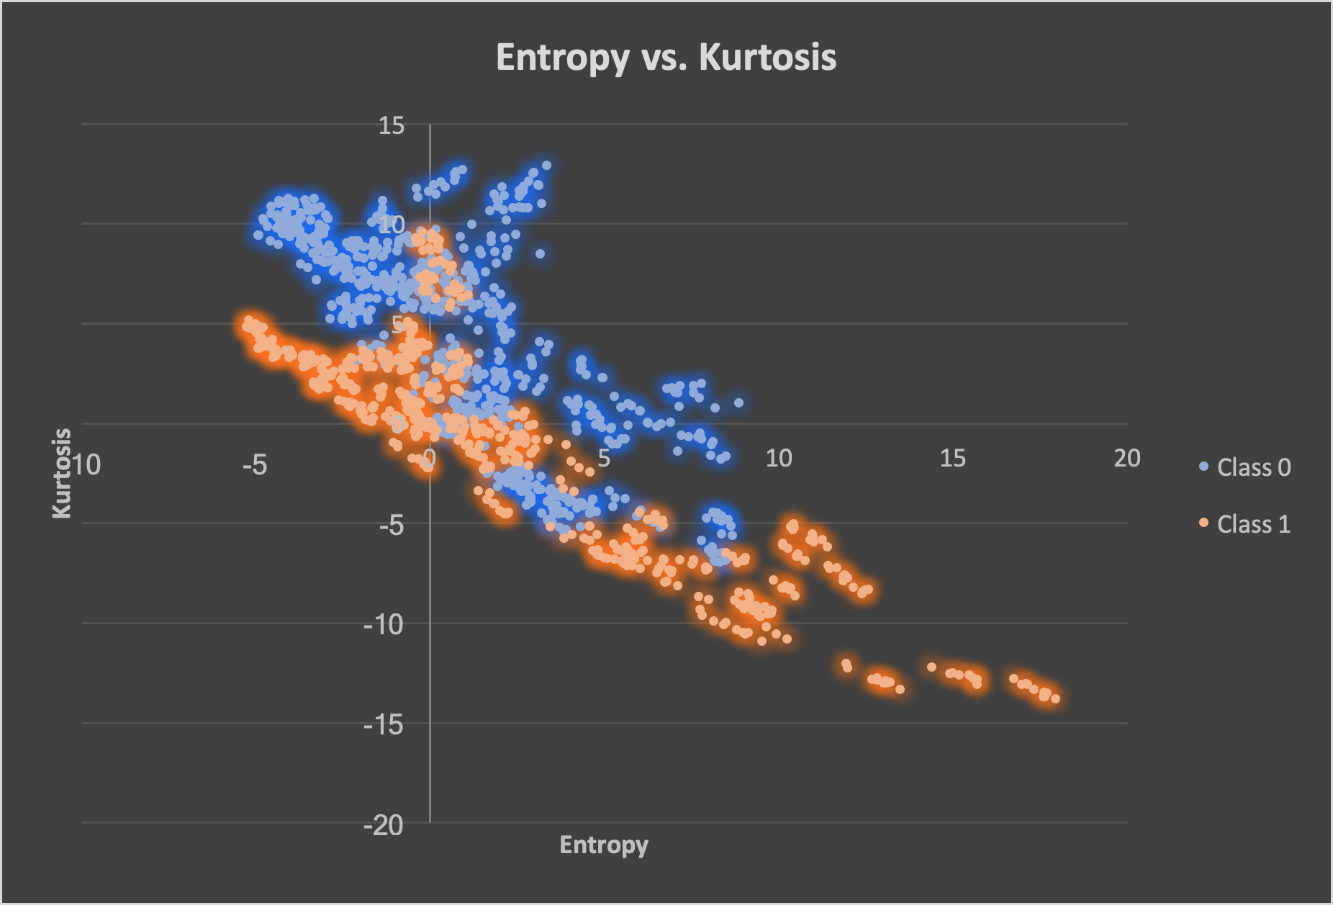

Slide 5
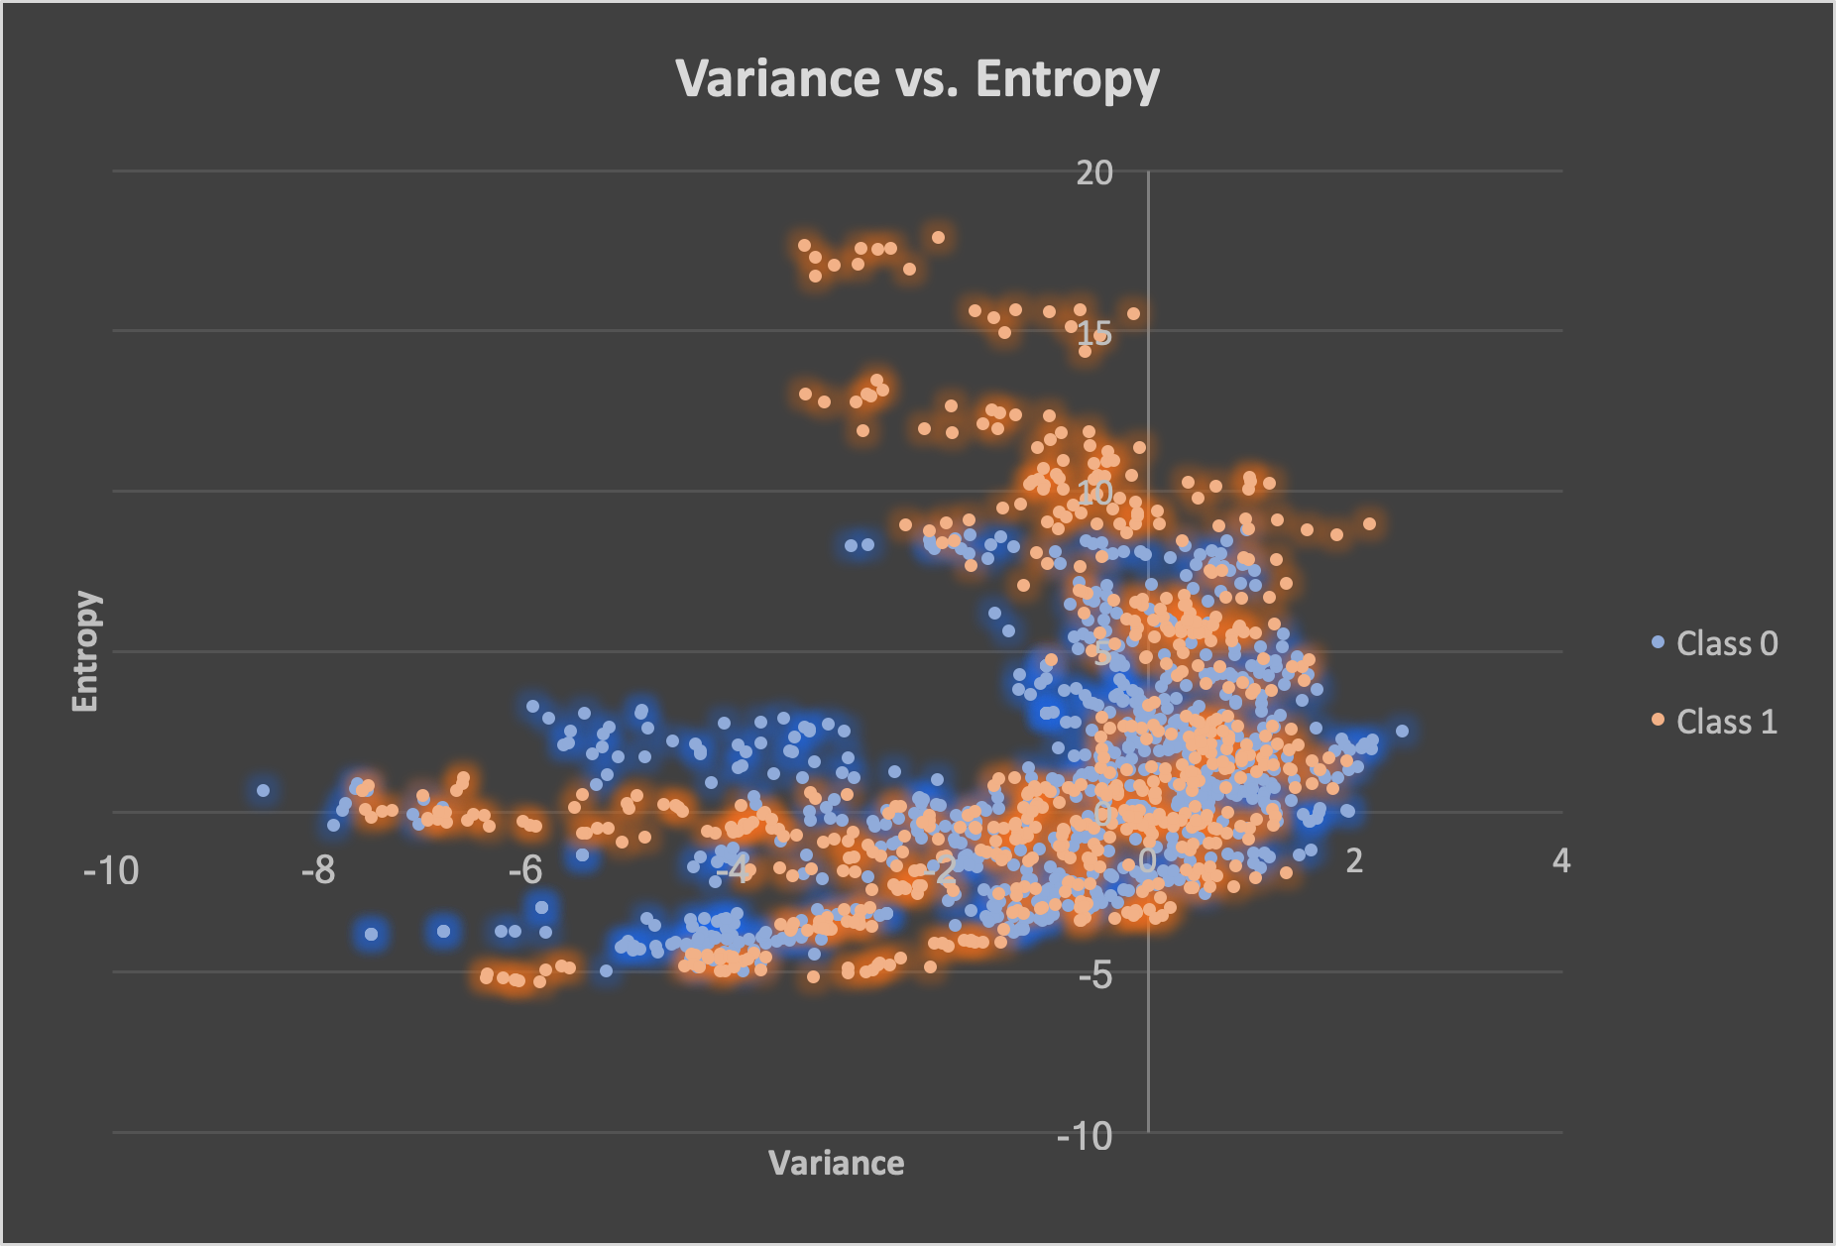

Slide 6
Analysis of Data and ML Algorithm Selection
→ Analyzing the data shows us that the data can be linearly classified for all combinations except for Variance vs. Entropy.
→ Because of this trend, we choose to use Binary Classification using Gradient Descent. We can either go with Perceptron Loss or Logistic Loss. We chose Perceptron Loss.

Slide 7
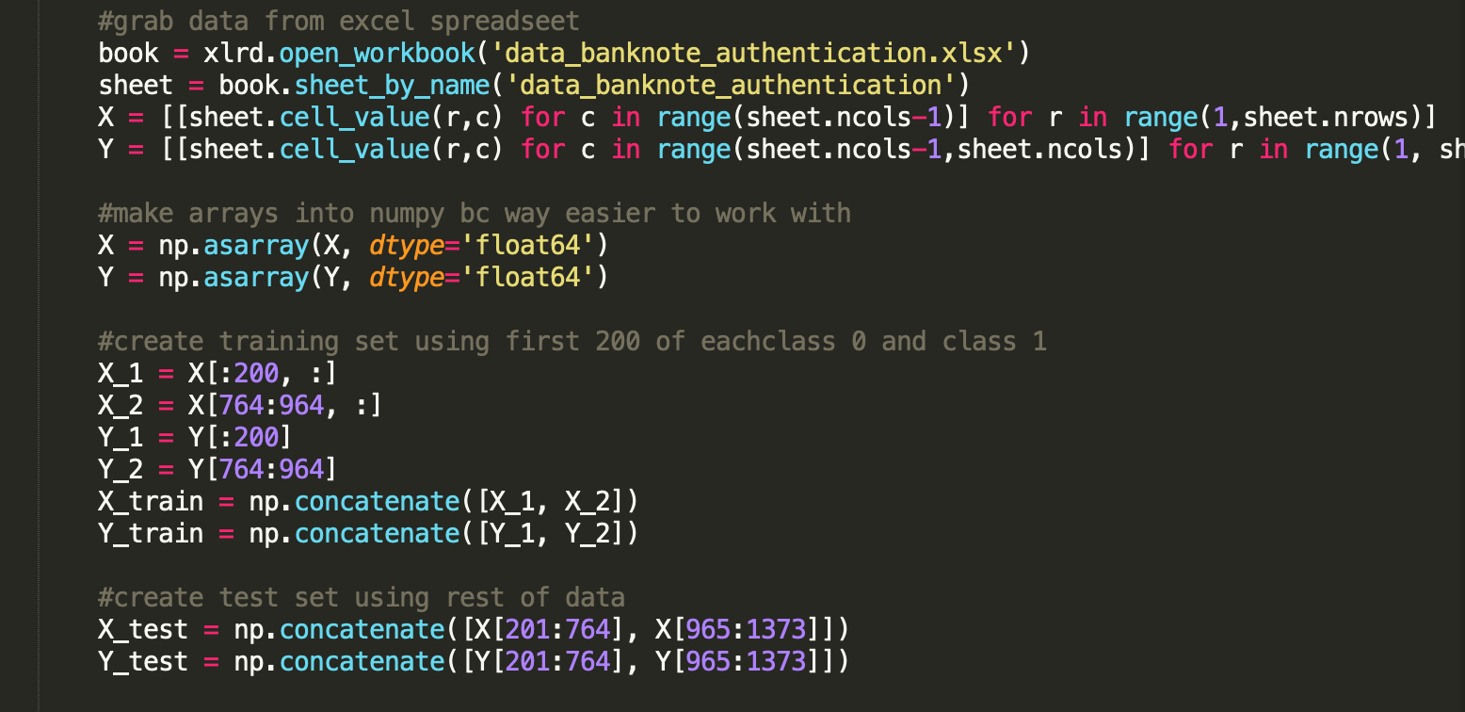
Writing the ML
→ You can use a python library or choose to write your own.
→ We went with the latter option as one of us already had one ready from a ML class here at USC.
→ When writing your code it is important to first divide the data into training data and test data.

Slide 8
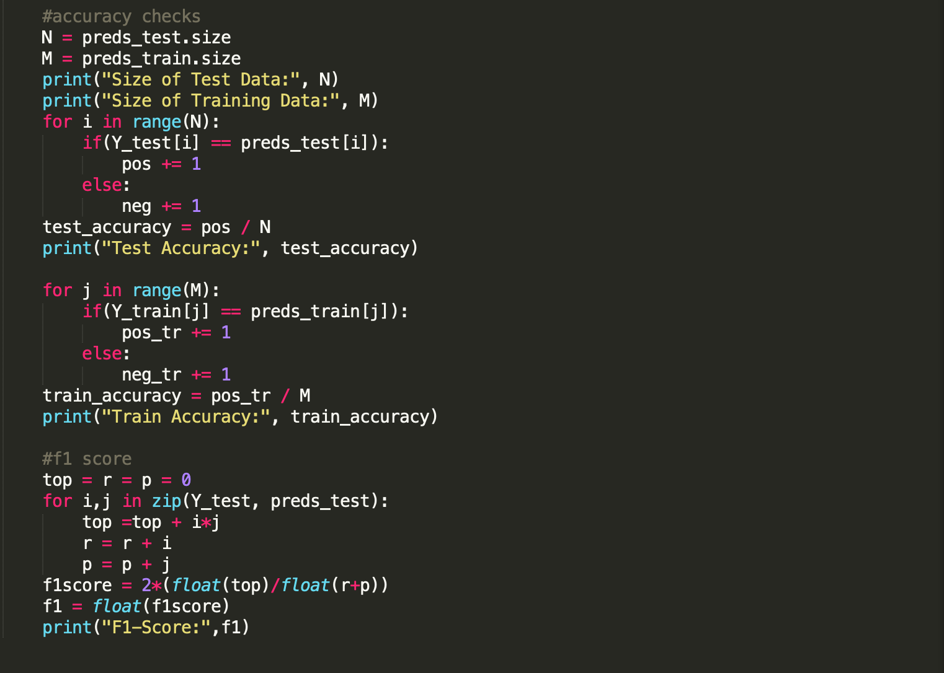
Train and Test The Data and Report Results

Slide 9
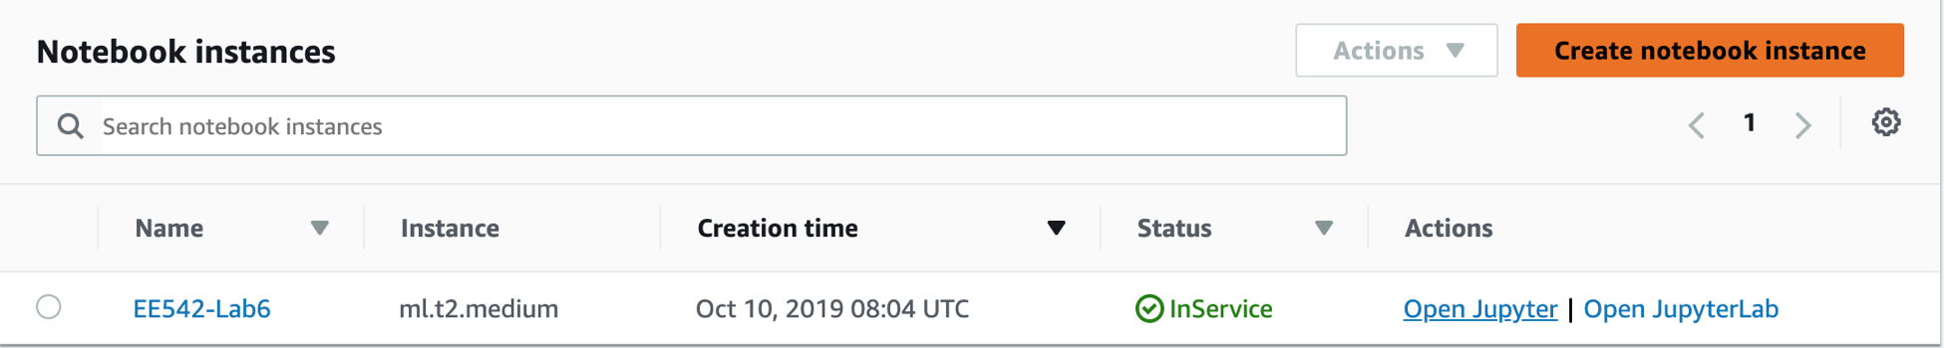
Part 1: AWS SageMaker
→ Login to AWS and navigate to AWS SageMaker
→ Create an instance and if unable to create one, there is a workaround
→ After creating instance, I was luckily able to open my instance on my web browser and did not have to go through the trouble of AWS CLI. Click Open Jupyter and it will take us to the browser environment.

Slide 10
AWS SageMaker
→ Now that we are in here, create a new file where your ML algorithm is gonna go and upload the banknote authentication data to an S3 bucket.
→ After uploading file to S3, update your algorithm to instead get data from the s3 instance.
train_data = 's3://{}/{}/{}'.format(bucket, prefix, 'train')
validation_data = 's3://{}/{}/{}'.format(bucket, prefix, 'validation')
→ This is the skeleton code to do so!!!!!

Slide 11
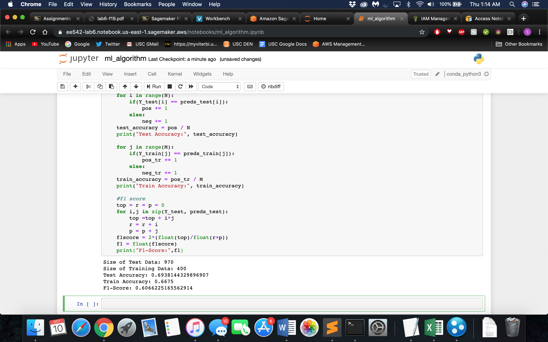
AWS SageMaker (cont…)
→ After opening Jupyter notebook, export your ML algorithm into the notebook. Best way to do this is to put one function per block so there is no issue with running the code. Now run the code block by block and get your results.
→ Don’t forget to stop the process after running your code using the stop sign. Also to be safe, go to Jupyter home menu and click on your .ipynb and hit Shutdown

Slide 12
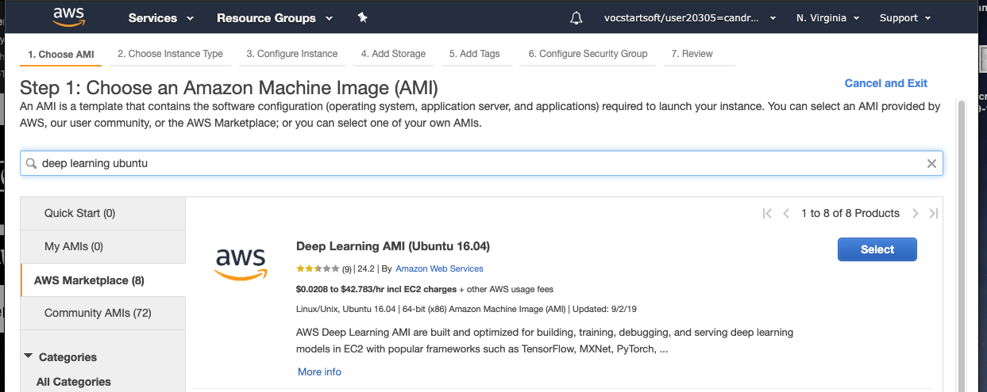
Part 2: Deep Learning AMI
Open a Deep Learning Ubuntu machine

Slide 13
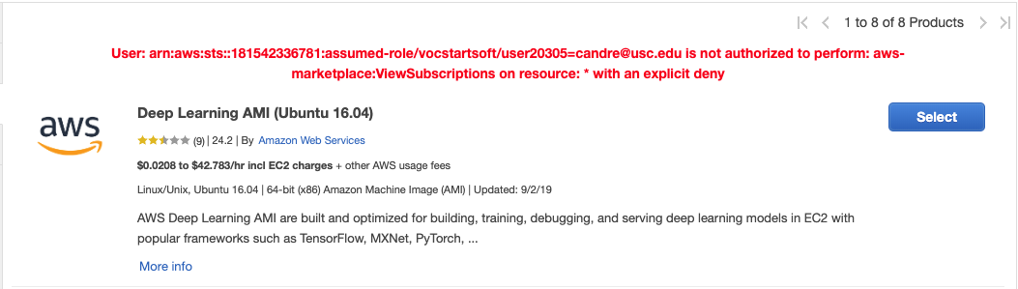
Try to open this AMI, get a weird error, open the base version

Slide 14
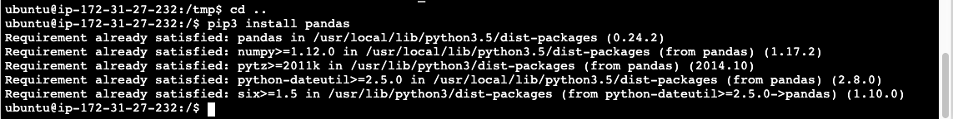
Install all needed libraries using pip install
This is an example of how you might install pandas

Slide 15
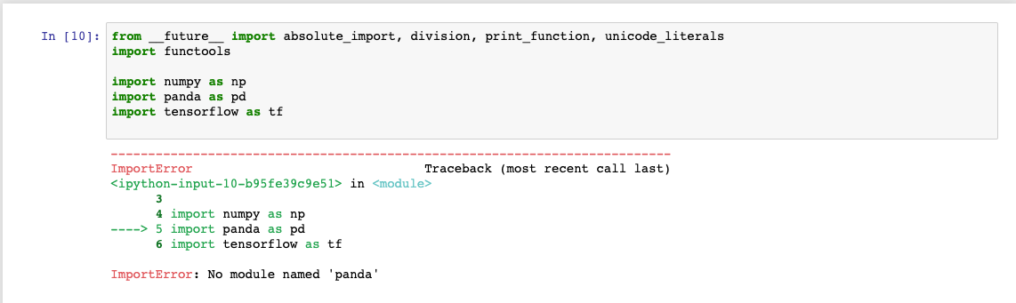
Remember to import “pandas” not panda

Slide 16
Open up the following tutorial:
https://www.tensorflow.org/tutorials/keras/regression
This tutorial trains a model using regression to produce a continuous value
I then rounded the continuous value to produce a 0 or a 1
The unrounded prediction is a great indicator for how certain the model is.
This can be used to avoid presenting a finding that your model is uncertain about
Finally!! A model that can tell you “I don’t know, but here is my best guess” when it is uncertain.

Slide 17
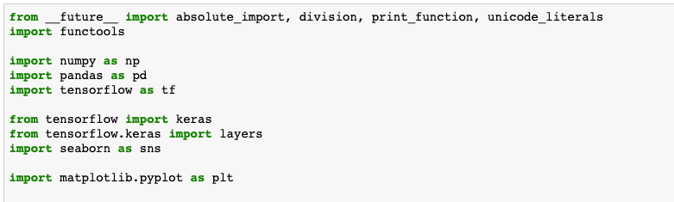
Import some libraries

Slide 18
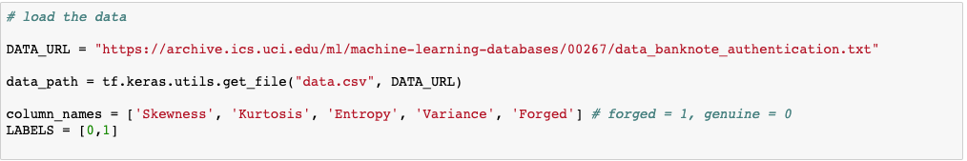
Load the data from the URL

Slide 19
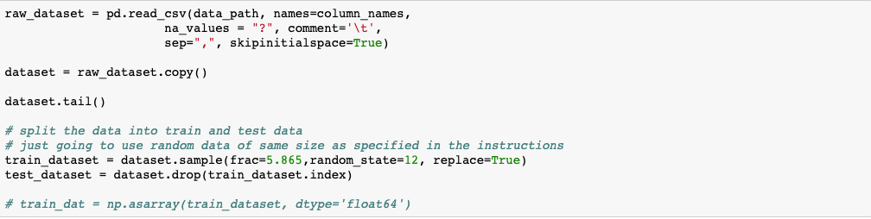
Clean the data and split into training and test data
I chose to go with a random sampling of the data to make this more realistic
The fraction of data for training and testing is the same as in part 1

Slide 20
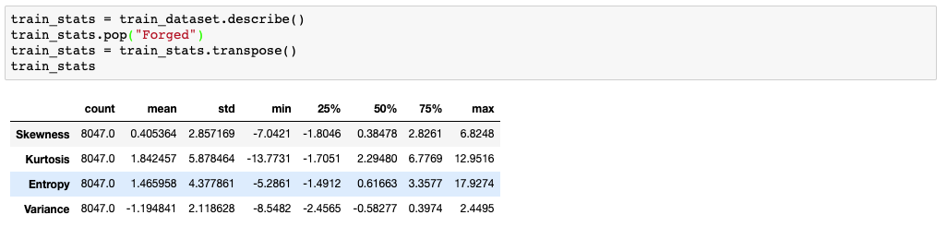
Get some info about the training data

Slide 21
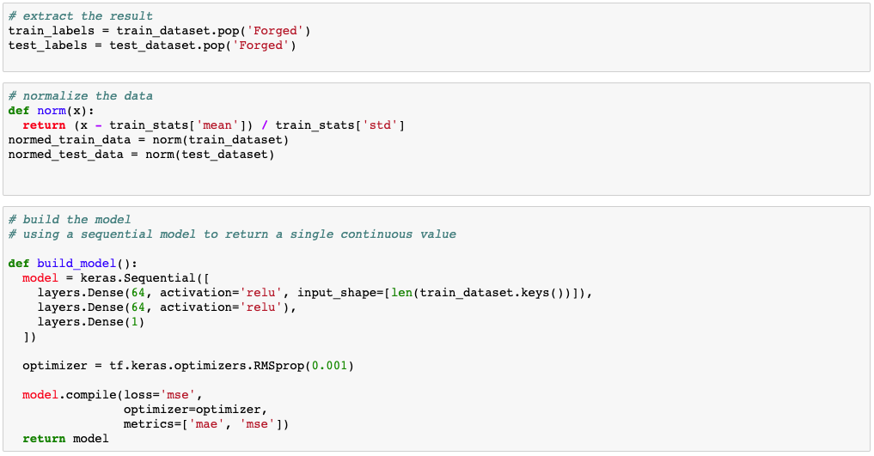
Normalize the data and build the model

Slide 22
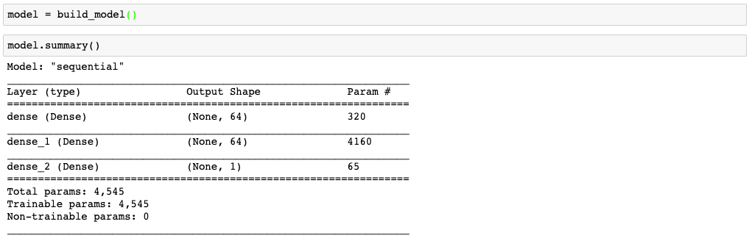
Check out the model

Slide 23
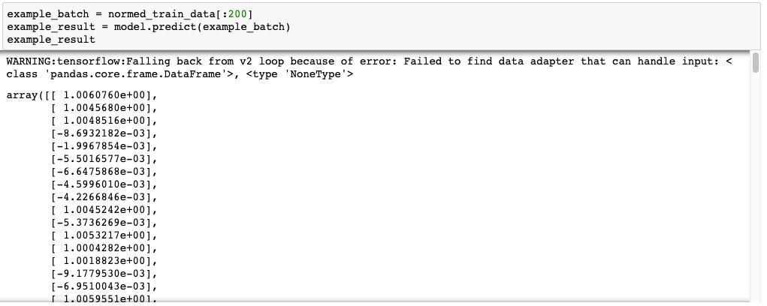
Run the model on some sample data

Slide 24
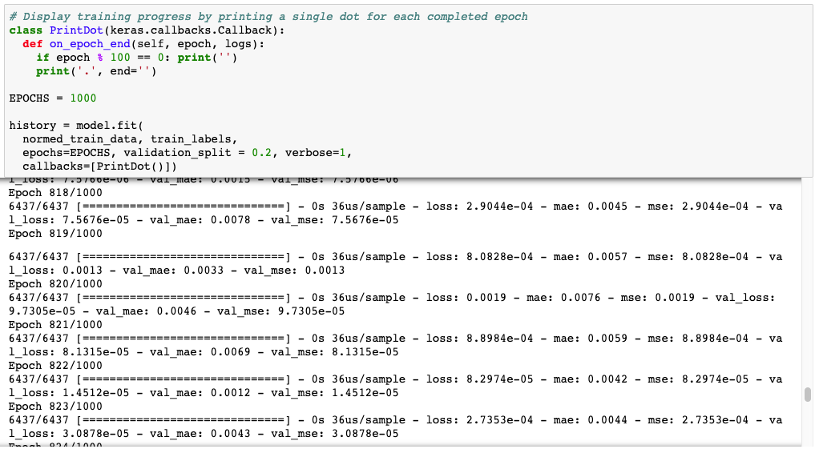
Train the model over 1000 Epochs

Slide 25
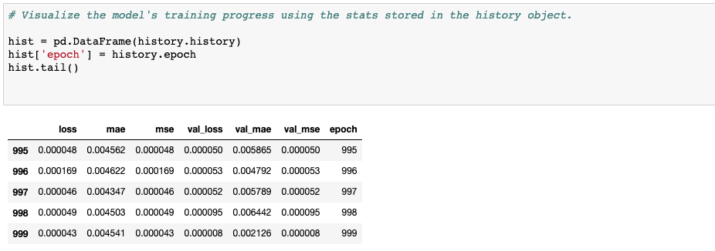
Check out the model’s progress

Slide 26
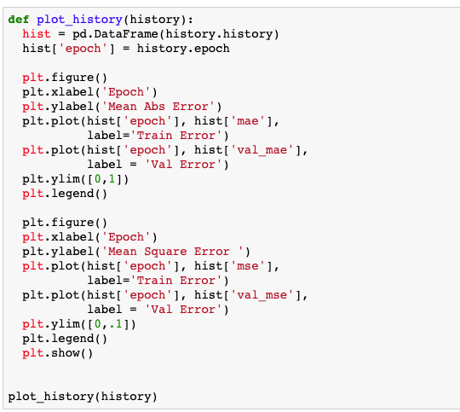
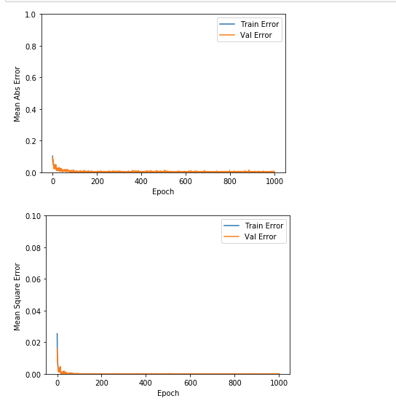
Plot the history of the model’s training

Slide 27
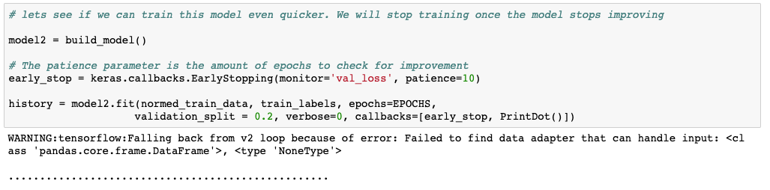
For fun, train another model, but stop training when it stops improving

Slide 28
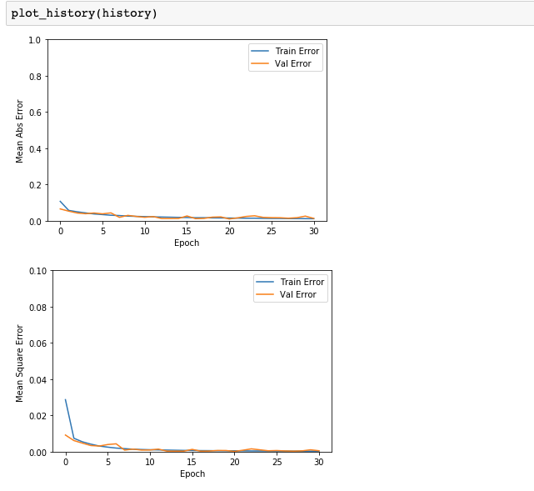
Plot the history of model2

Slide 29
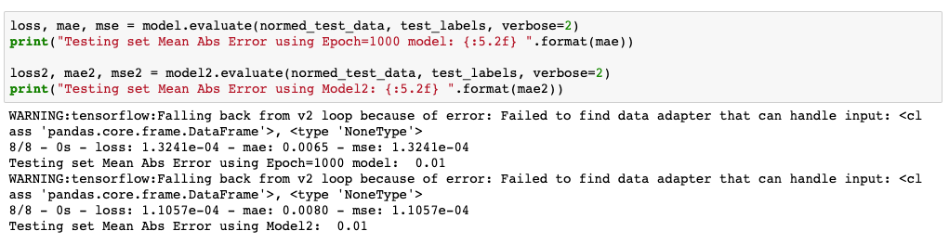
Compare the 2 Models
As you can see, the model trained over ~30 Epochs is not much worse than the modeled trained over 1000 Epochs

Slide 30
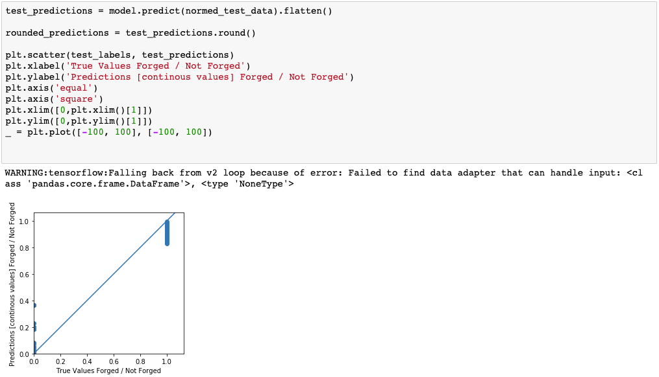
Plot the predictions that you made
It is useful to have a continuous prediction value. This way you can get a measure for how certain you really are of your rounded estimate

Slide 31
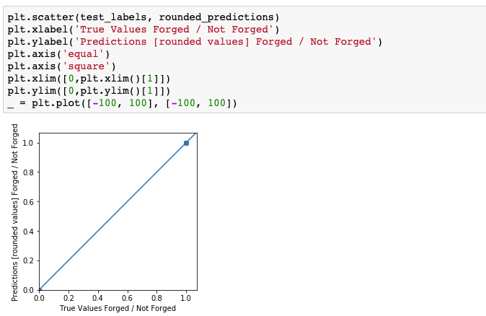
Round the predictions and plot

Slide 32
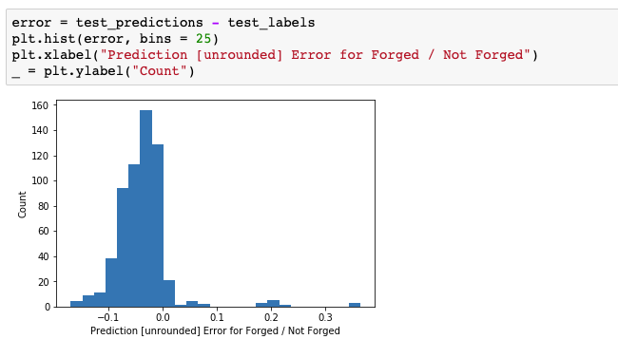
Plot the error for the continuous predictions
These results are pretty exciting. There is hardly much error, which means that this model is very certain in its choices

Slide 33
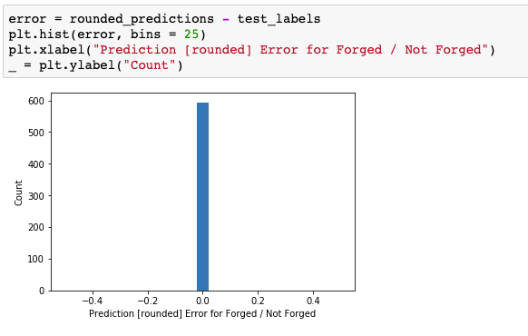
Plot the error in the rounded output
This means that the model was 100% accurate in its predictions. Thank you tensorflow

